Slide 1
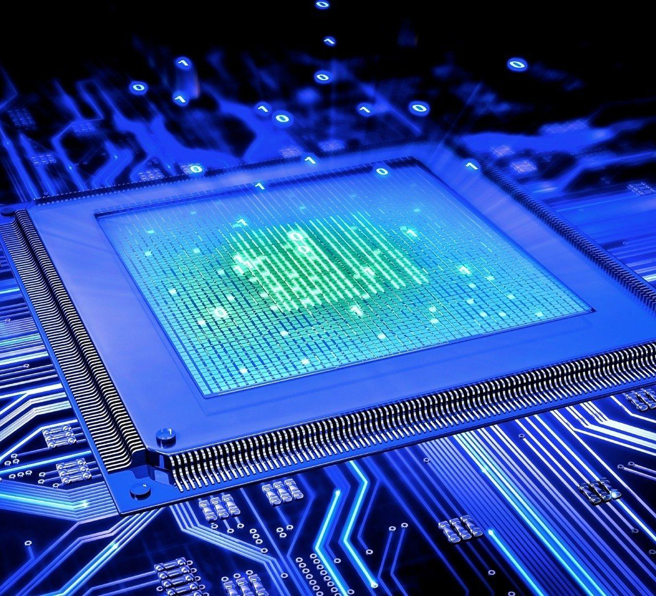
IoT Project Contactless Breakout
Team Name
YYAT is Yet Another Team

Slide 2
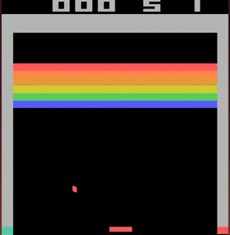
Project Aim
The basic aim of the project is to play the game “Atari Breakout” with a contactless controller made using an ultrasonic sensor and esp32.
Further, the goal is to analyze all the data collected from the game to give instantaneous analysis of the game and store the records of high score for giving an overtime analysis of the current player’s performance.

Slide 3

How this works? A basic overview
Ultrasonic sensor measures the distance of the hand/object being used by the user to play
Arduino sets up webserver and serves game page on / and ultrasonic data is served on /data.txt. The game page is made with JavaScript.
The browser accesses the webpage and the webpage makes a get request to /data.txt through JavaScript to get the data and move the platform accordingly
Now, the analysis page which is hosted on the flask server sends a get request to oneM2M given a game ID. The analysis page uses JavaScript to present the analytics (using plotly to create the required graphs)
Arduino receives the data and posts it to oneM2M. We cannot post to oneM2M directly from the website because of CORS policy.
On end, the game returns the game ID.
After the game ends, the webpage posts data to the Arduino webserver on /postdata through JavaScript

Slide 4


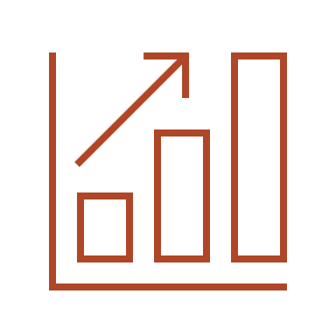

Features
Target user
Cost
Since Atari breakout is a classic game enjoyed by all age groups alike, the age of the target user spans from child to elderly alike.
Low cost since all it requires an esp32 and an ultrasonic sensor. The initial plan utilized multiple ultrasonic sensors for accurate measurement, but using filtering conditions and smoothing algorithms, we managed to implement it with only one ultrasonic sensor.
Competitiveness
The analysis part of the game makes the game competitive to encourage players to try harder and climb the rankings. The score is not only affected by number of tiles broken but also the time to do so making the game highly competitive and fun.
Usability
Players want an easy to use and involved interface. This device gives much more involvement with the game than traditional devices like keyboard/mouse.

Slide 5

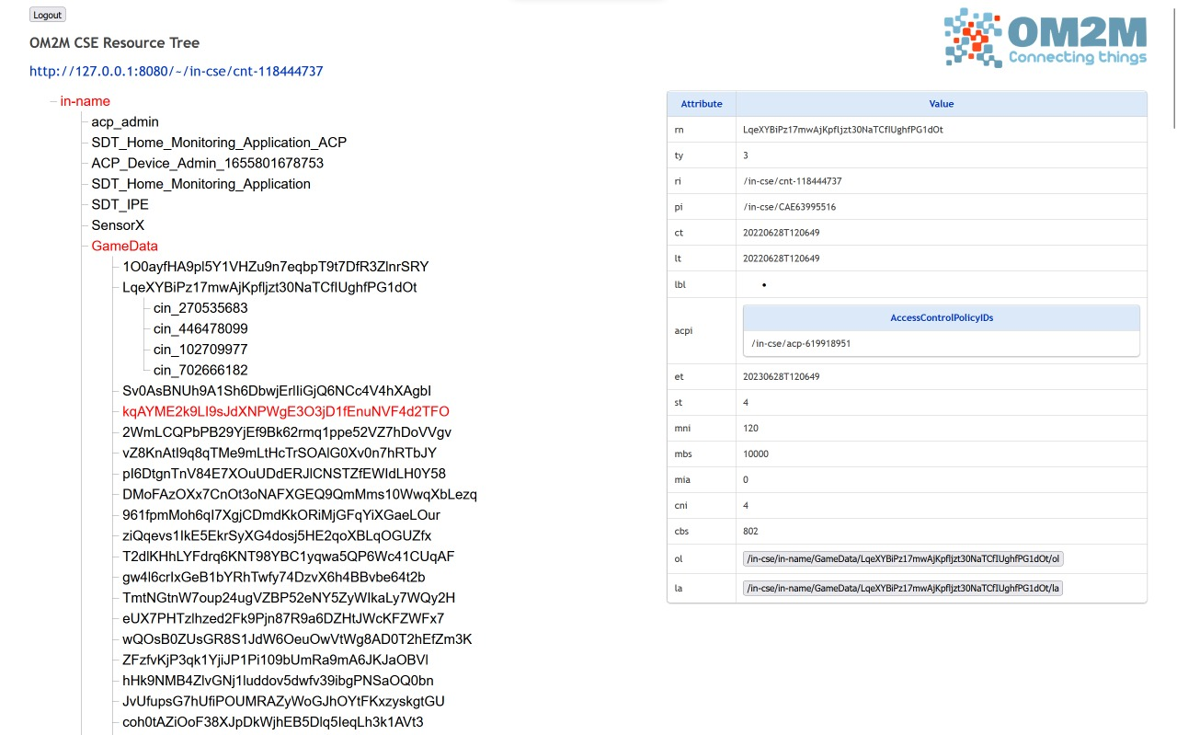
Where is oneM2M involved in all of this?
Using our JavaScript based website, we make post requests to the oneM2M server hosted on the computer. For each game played, we post one container with a unique “Game ID” to oneM2M which contains the following 4 instances :
Time : An array of times at which we measured data
Position (Ball) : An array of position of ball with time
Position (Platform) : An array of position of the platform with time.
Score : The final score achieved by the user
All of this data can be later fetched for analysis with the help of graph and percentile to find how well a particular game was played.

Slide 6

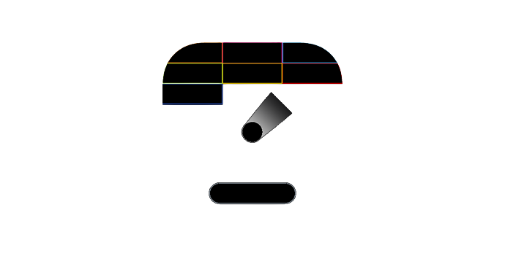
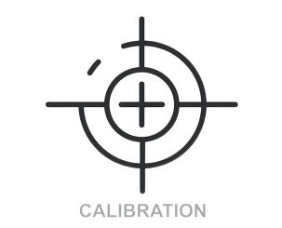
Setting up and starting the device
Calibration phase
Before starting the device, it must be calibrated according to the screen size of the display device used for this game.
Initializing phase
All the servers namely the Arduino webserver, oneM2M and flask server must be up and running properly before a game is started.
Starting a game
When a new game is started, Arduino serves the game and the data which is then fetched by the game website.

Slide 7
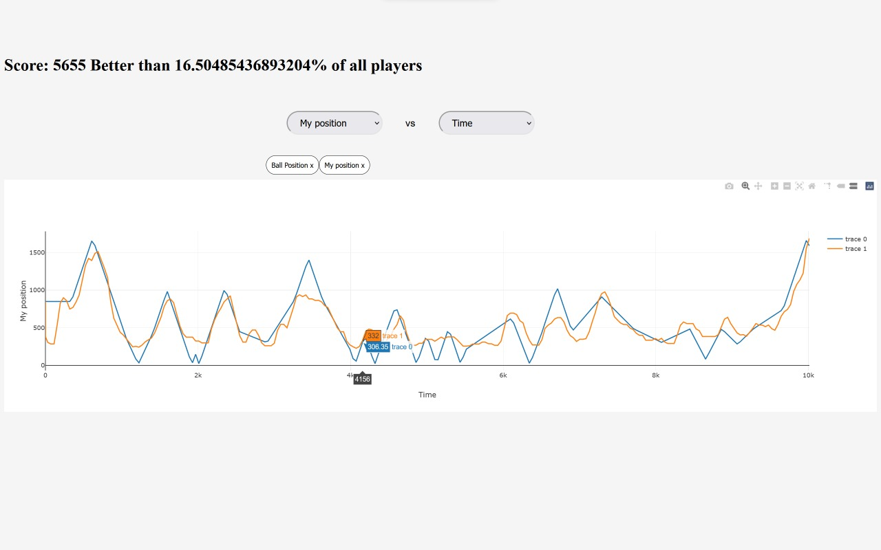
Analysis
How we utilize the data collected throughout the course of the game?
For the analysis of a game, we have another server running in which we use Flask for getting and presenting data. Our flask program makes a get request from the oneM2M server based on the entered unique Game ID and displays it in the form of a graph. It also analyses how good a game was played by comparing it with other already played games using a percentile system.

Slide 8
What can we infer from the graphs?
Ball and Platform graphs against time
Percentile
Select what to plot
The position graph can be used to find if the player is falling behind or if he is able to trail the ball by comparing position of the ball and platform.
Similarly, with the speed graph, we can get an estimate of the reaction speed of the player as time passes.
With the help of the position vs time graph, we can get a fairly good understanding of how a game went even without having looked at the original game.
Graph

Slide 9
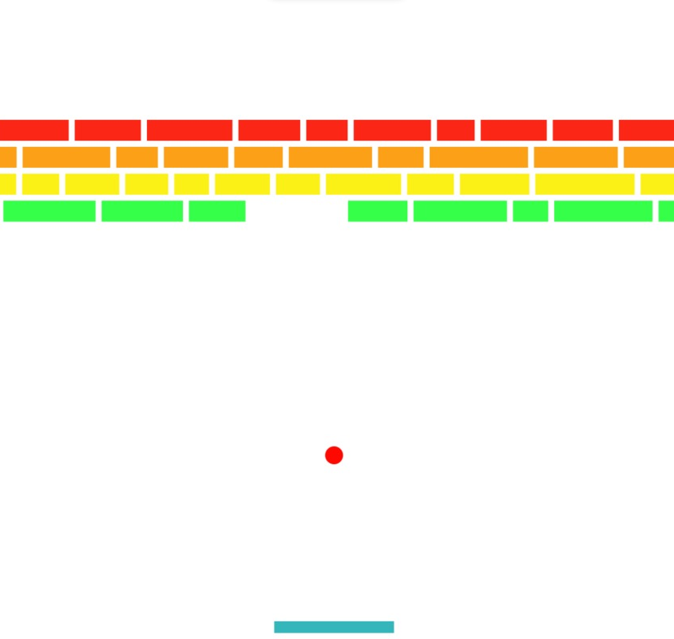
The Percentile system
Why is this important?
What it does?
The analysis page of our project, fetches the scores of each game uploaded to the oneM2M server. It compares the current score to each one of them and finds how many players the current player has managed to beat.
Since the player is given an analysis of their performance against other players, this encourages the player to perform better.
This provides incentive to a player for investing time in getting a better score.

Slide 10
Thank you
Team YYAT is Yet Another Team
Divij – 2021101001
Ishwar – 2021101023
Vennam – 2021101045
Bhargav - 2021101065

